Slide 1
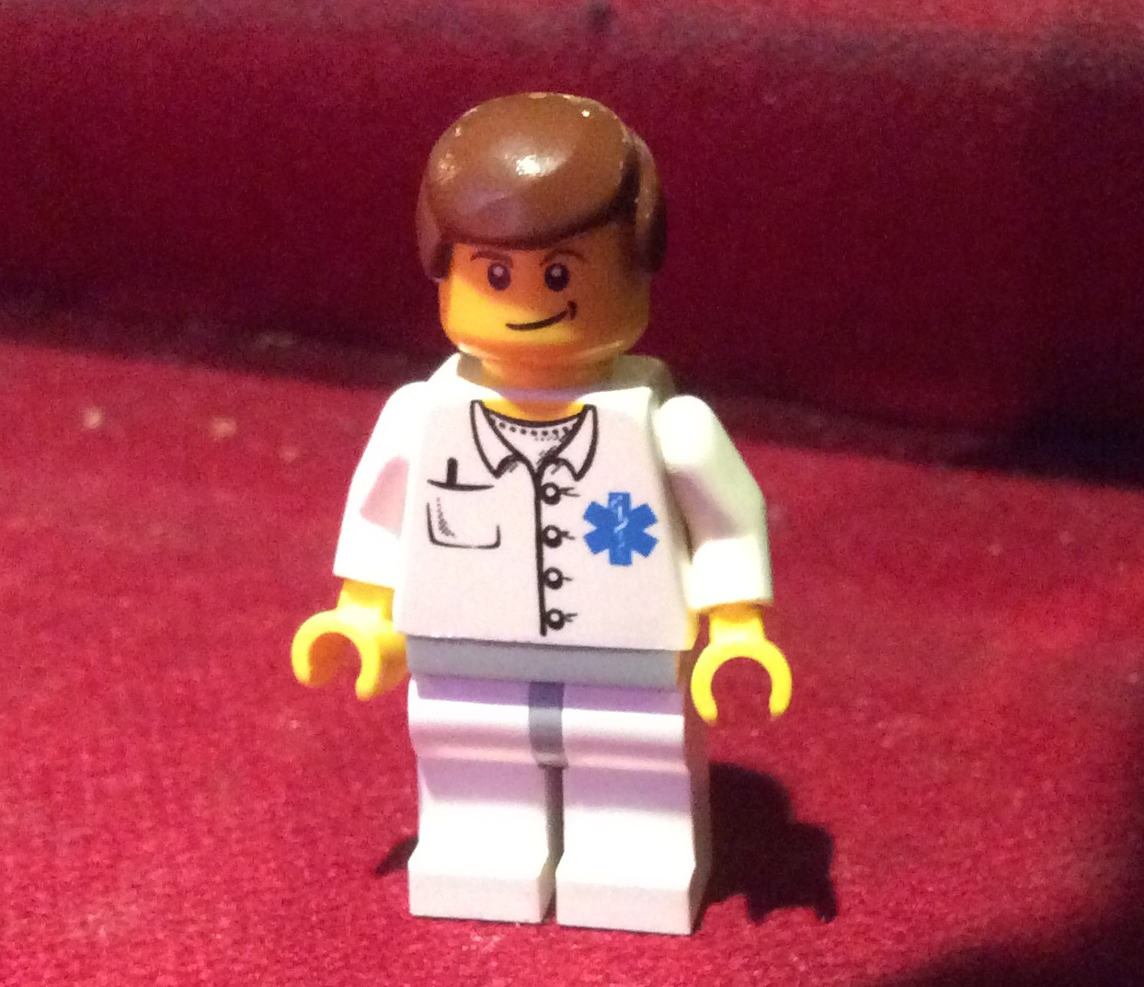
This is Joe. He got lost.

Slide 2
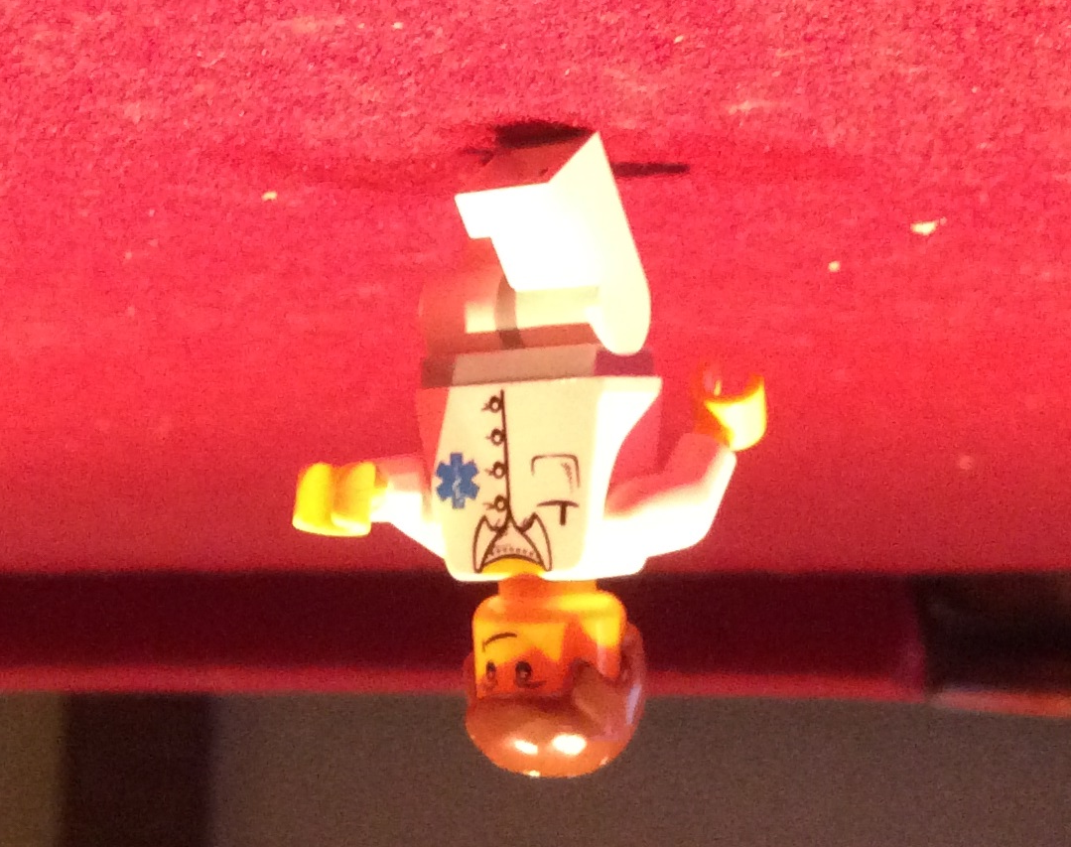
Civilization,
Technology
He walked and walked…

Slide 3
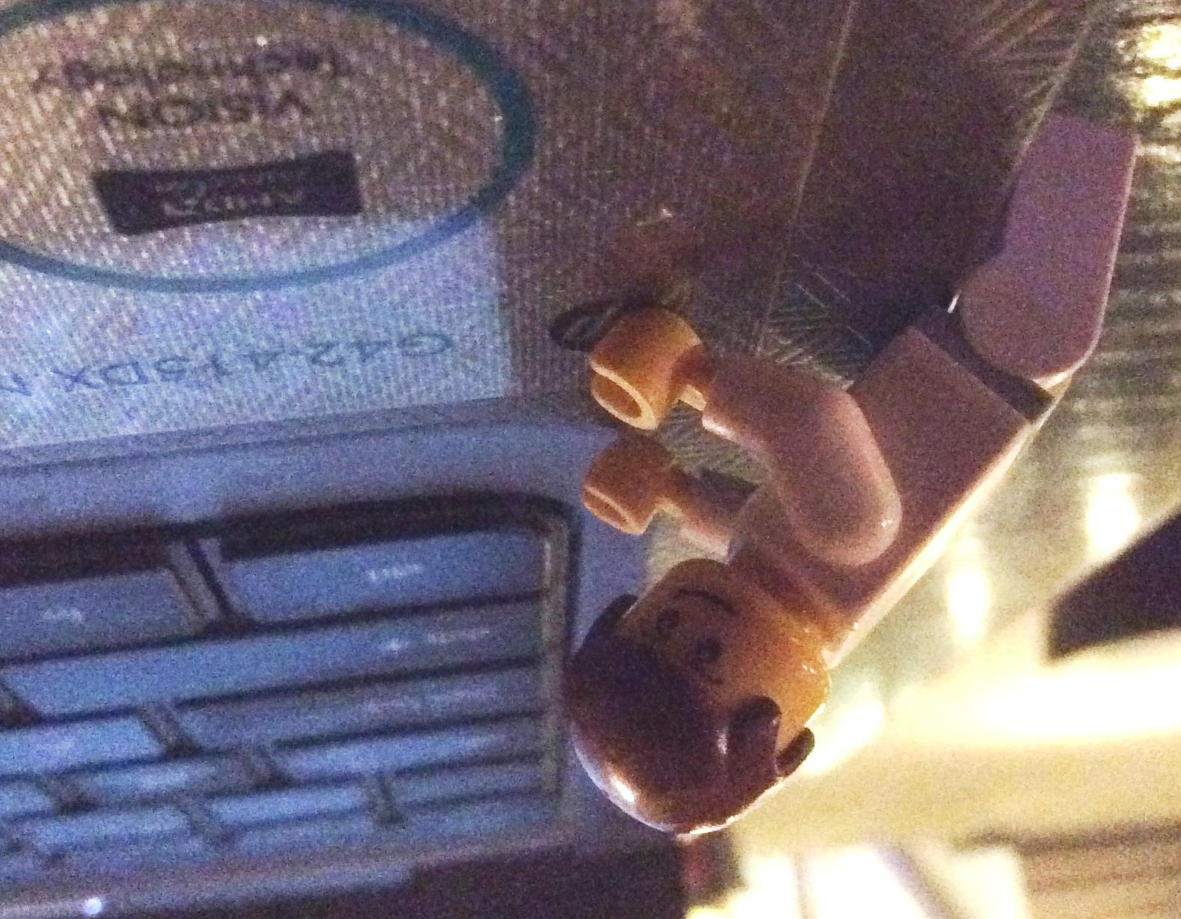
?
He found a gigantic keyboard!

Slide 4
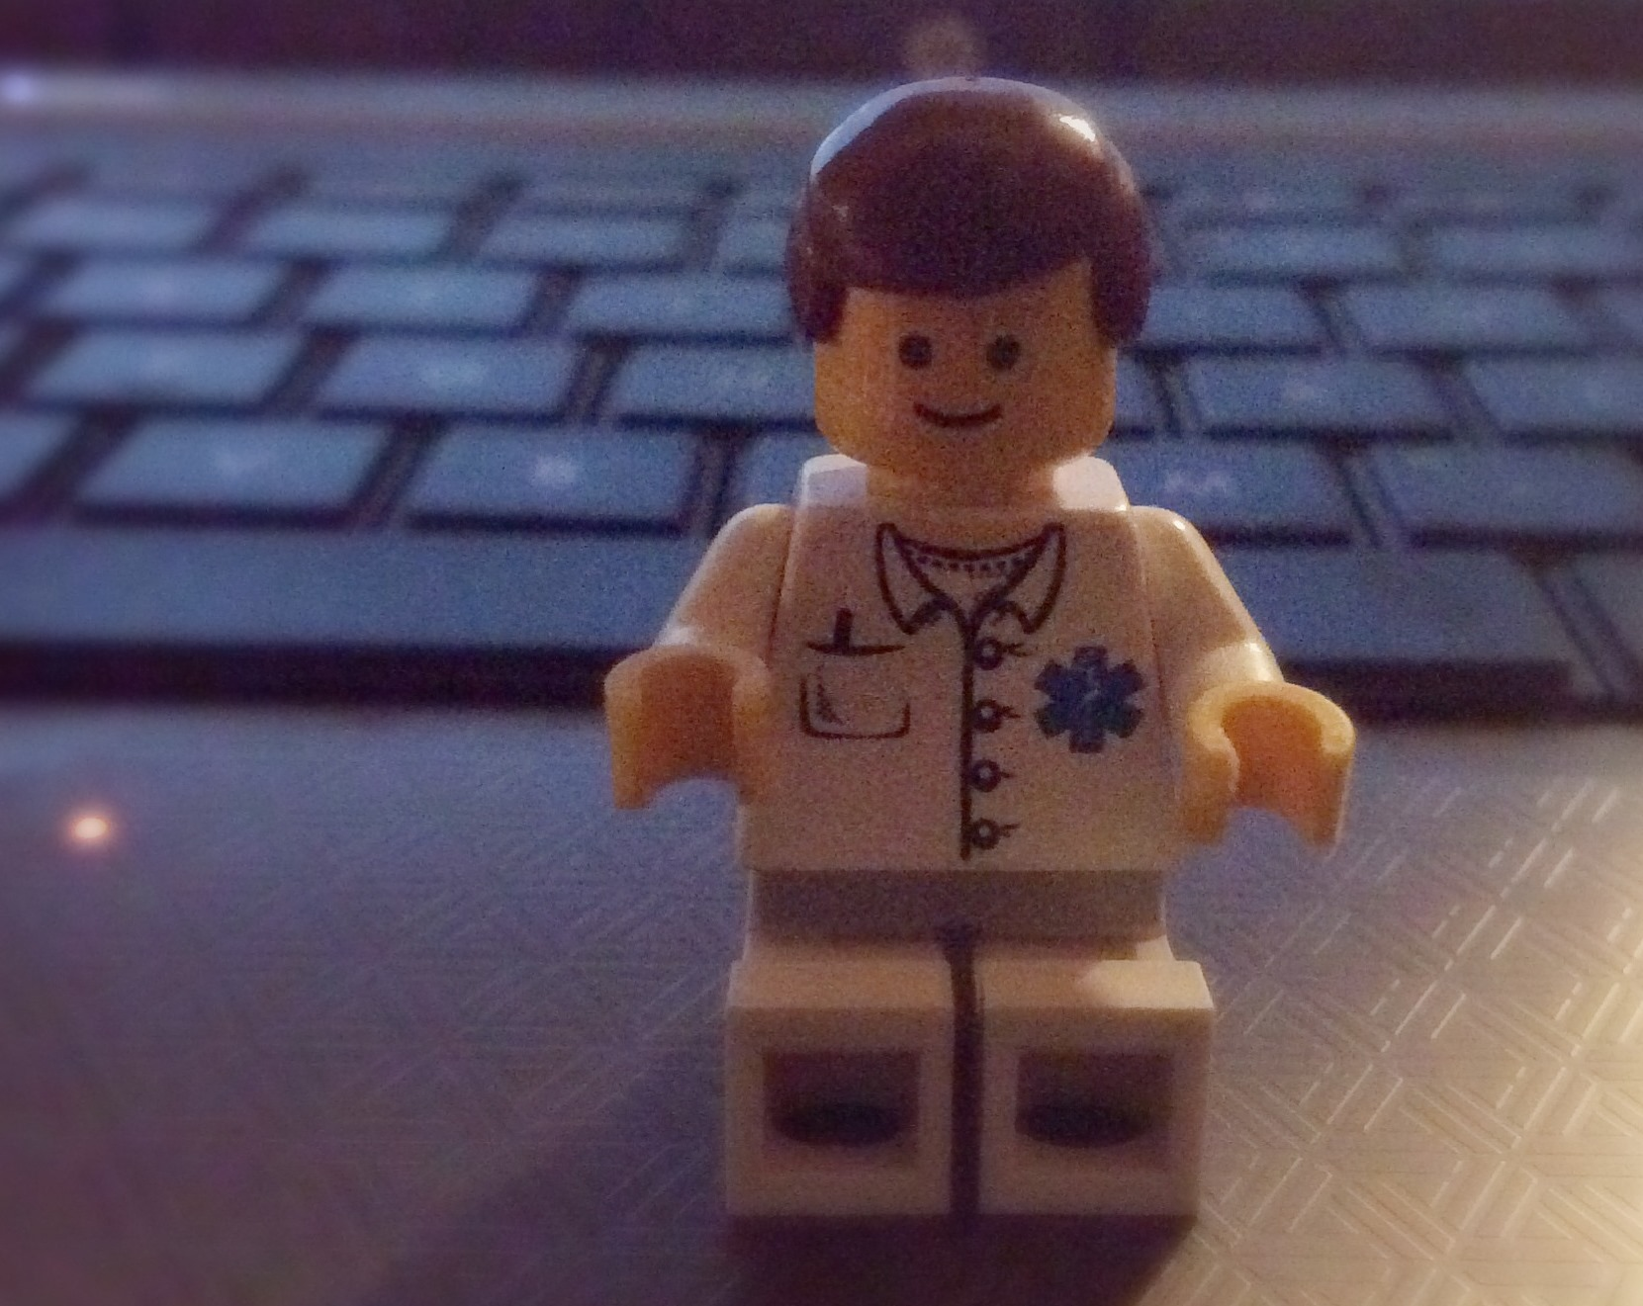
He climbed up and sat down.

Slide 5
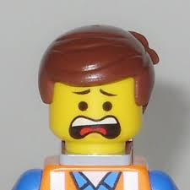
What happened next?
Write the rest of the story….

